Slide 1
Anomalies of systemic venous return
Mahta Allsop

Slide 2
Introduction
The embryogenesis of the IVC is a complex process involving the formation of several anastomoses between three paired embryonic veins. The result is numerous variations in the basic venous plan of the abdomen and pelvis.
The infrahepatic IVC develops between the 6th and 8th weeks of embryonic life as a composite structure formed from the continuous appearance and regression of three paired embryonic veins. In order of appearance, they are the posterior cardinal, the subcardinal, and the supracardinal veins

Slide 3


Slide 4
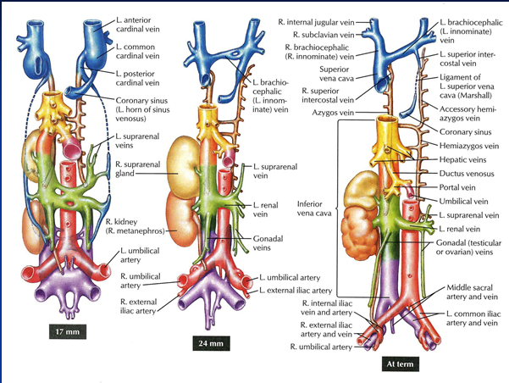

Slide 6
Classification
Left IVC
typically ends at the left renal vein, which crosses anterior to the aorta to form a normal right-sided prerenal IVC.
Double IVC
the left IVC typically ends at the left renal vein, which crosses anterior to the aorta to join the right IVC. It includes these two subcategories:
Double IVC with retroaortic Right Renal Vein and
Hemiazygos Continuation of the IVC and
Double IVC with retroaortic Left Renal Vein and
Azygos Continuation of the IVC.
Azygos continuation of the IVC
the prerenal IVC passes posterior to the diaphragmatic crura to enter the thorax as the Azygos vein.
Other anomalies include absence of the infrarenal IVC or the entire IVC.
The rest are associated with the renal veins and the IVC. The many anomalies listed are out of the scope of this presentation.
These anomalies are usually associated with Dextrocardia and Polysplenia.

Slide 7
http://www.youtube.com/watch?NR=1&v=eOuF4B5-Ls0
http://www.embryology.ch/anglais/pcardio/venen01.html#Kardinales

Slide 8
Left IVC
A left IVC results from regression of the right supracardinal vein with persistence of the left supracardinal vein.
The prevalence is 0.2%–0.5%
Typically, the left IVC joins the left renal vein, which crosses anterior to the aorta in the normal fashion, uniting with the right renal vein
to form a normal right-sided prerenal IVC .
The major clinical significance of this anomaly is the potential for misdiagnosis as left-sided paraaortic adenopathy. In addition,
rupture of an abdominal aortic aneurysm into a left IVC has been
reported. Transjugular access to the infrarenal IVC for placement of
an IVC filter may be difficult.
Notes:
Left IVC

Slide 9
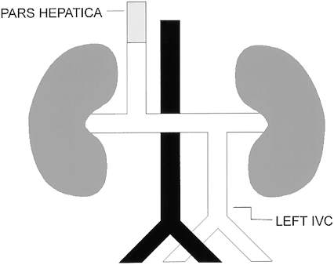

Slide 10
Double IVC
Duplication of the IVC results from persistence of both supracardinal veins.
The prevalence is 0.2%–3% .
The left IVC typically ends at the left renal vein, which crosses anterior to the aorta in the normal fashion to join the right IVC. However, there may be variations in this arrangement. There may be significant asymmetry in the sizes of the left and right veins.
Double IVC should be suspected in cases of recurrent pulmonary embolism following placement of an IVC filter. As with left IVC, misdiagnosis of the aberrant vessel as lymphadenopathy should be avoided.

Slide 11
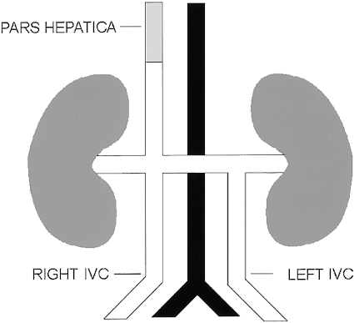
Notes:
Double IVC

Slide 12
Azygos Continuation of the IVC
Azygos continuation of the IVC has also been termed absence of the hepatic segment of the IVC with azygos continuation . The embryonic event is theorized to be failure to form the right subcardinal–hepatic anastomosis, with resulting atrophy of the right subcardinal vein. Consequently, blood is shunted from the suprasubcardinal anastomosis through the retrocrural azygos vein, which is partially derived from the thoracic segment of the right supracardinal vein.
The prevalence is 0.6%.
Formerly thought to be predominantly associated with severe congenital heart disease and asplenia or polysplenia syndromes, azygos continuation of the IVC has become increasingly recognized in otherwise asymptomatic patients since the advent of cross-sectional imaging. It is important to recognize the enlarged azygos vein at the confluence with the superior vena cava and in the retrocrural space to avoid misdiagnosis as a right-sided paratracheal mass or retrocrural adenopathy. Preoperative knowledge of the anatomy may be important in planning cardiopulmonary bypass and to avoid difficulties in catheterizing the heart

Slide 13
Notes:
Azygos continuation of the IVC

Slide 14
Notes:
Absence of Infrarenal IVC

Slide 15
Notes:
On the left Double IVC with a retroaortic left renal vein and azygos continuation and on the right Double IVC with
Retroaortic Right Renal Vein and Hemiazygos Continuation of the IVC

Slide 16
References
Spectrum of Congenital Anomalies of the Inferior Vena Cava
J. Edward Bass, MD • Michael D. Redwine, MD • Larry A. Kramer, MD Phan T. Huynh, MD • John H. Harris, Jr, MD, DSc

Slide 17
Questions and Answers
What are the three embryonic paired veins that make up the IVC?
The posterior cardinal, the subcardinal, and the supracardinal veins.
What is the most prevalent form of IVC anomaly?
Double IVC
How is double IVC formed?
Duplication of the IVC results from persistence of both supracardinal veins.
What are IVC anomalies usually associated with?
Associated with Dextrocardia and Polysplenia.
What is another term for Azygos continuation of the IVC?
It has also been termed absence of the hepatic segment of the IVC with azygos continuation .
What misdiagnosis seems to be associated with IVC anomalies?
Lymphoadenopathy.
How is Left IVC formed?
A left IVC results from regression of the right supracardinal vein with persistence of the left supracardinal vein.
What is the crus of the diaphragm?
The crura of the diaphragm (singular: crus) are tendinous structures that extend inferiorly from the diaphragm to attach to the vertebral column. Forming a tether for muscular contraction, they take their name from their leg-shaped appearance
A recurrent pulmonary embolism following placement of an IVC filter could point to what anomaly?
Double IVC.
Which type of operation could be problematic if these types of anomalies are not known?
Cardiopulmonary bypass and Catheterization.

